Slide 1
Allusion
Definition: a reference within a work to something famous outside of it.
Purpose: Lets audience understand new information by connecting it to something they know.

Slide 2
Allusion: Explain what they are adding…
Your backyard is a Garden of Eden. (Biblical allusion)
You're a regular Einstein. (allusion to a historical figure)
When your parents learn about your new plan to raise money, it's going to sink like theTitanic. (allusion to a historical event)
Don't be a Scrooge! (reference to A Christmas Carol by Charles Dickens)
Potato chips are my diet's Achilles heel. (reference to Achilles in Greek mythology)

Slide 3
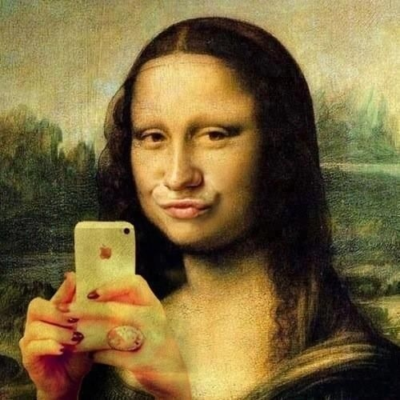
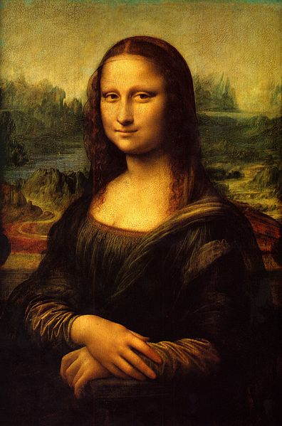
Sally had a smile that rivaled that of the Mona Lisa.

Slide 4
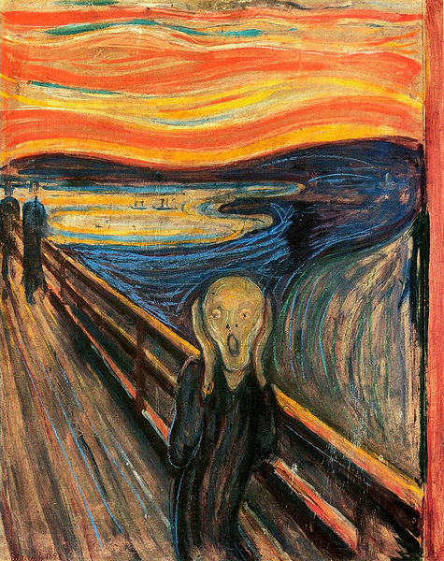
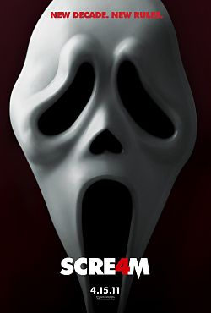
The makers of the Scream movie ALLUDED TO Munch’s work of art “The Scream” in order to instill fear.

Slide 5
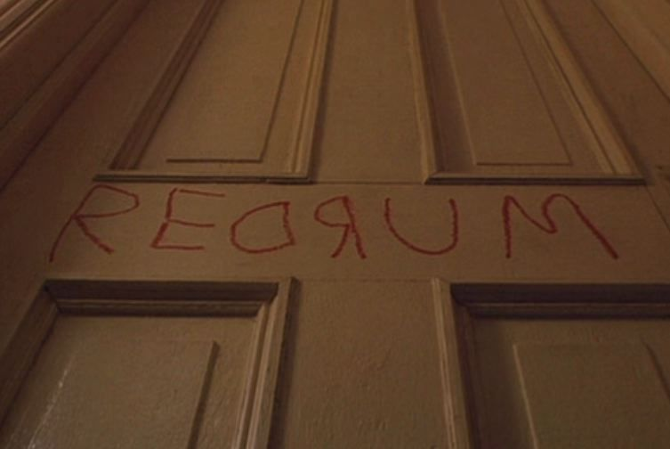
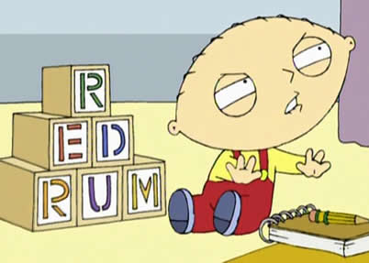
The makers of Family Guy make Stewie’s blocks say “REDRUM” as an ALLUSION TO The Shining.
They use this allusion because they know their audience will likely be familiar with The Shining, so they will understand the message that Stewie is obsessed with murder.

Slide 6
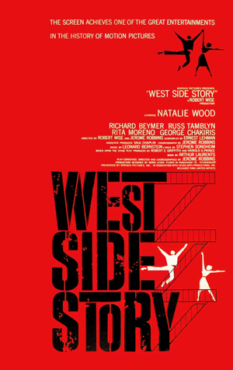

Slide 7
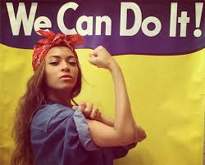

Slide 8
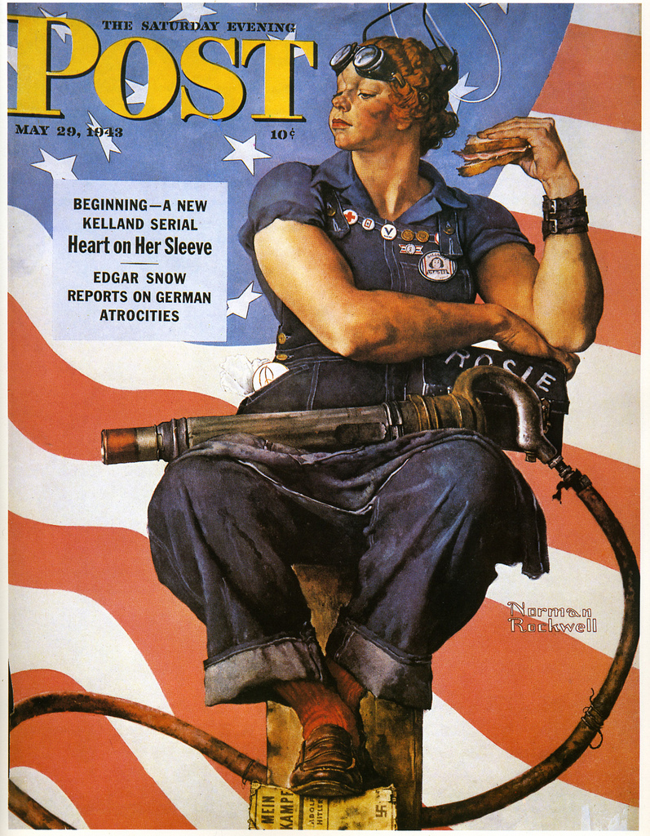

Slide 9
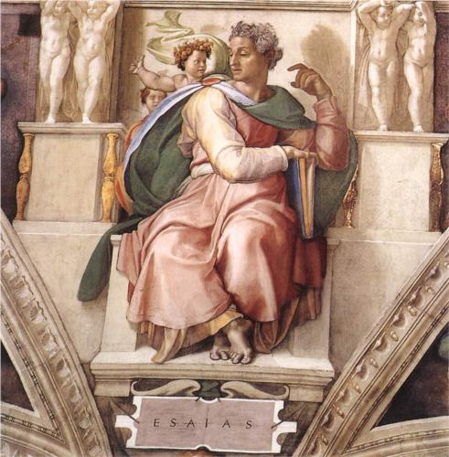
Prophet Isaiah, detail from the Sistine Chapel, Michelangelo
WHAT COULD ROCKWELL BE SAYING ABOUT WOMEN?
Suffering Servant
Kingdom of Judea vs. Assyrians: war
Birth of son of God and the crucifixion: salvation

Slide 10
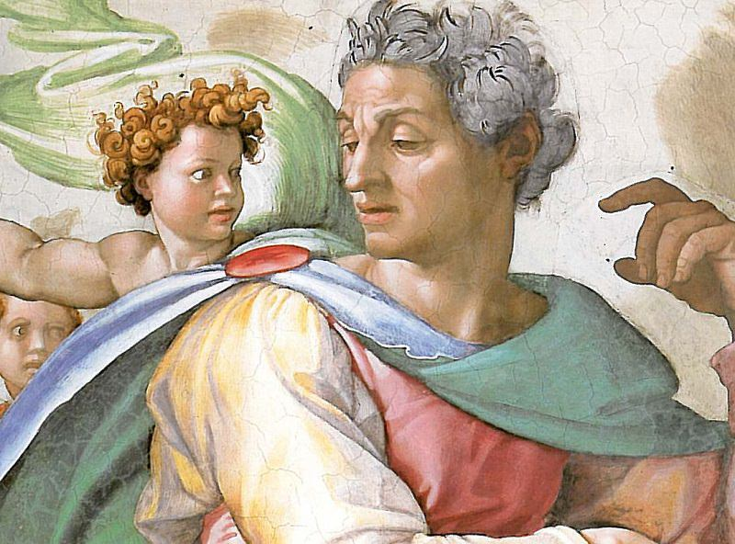

Slide 11
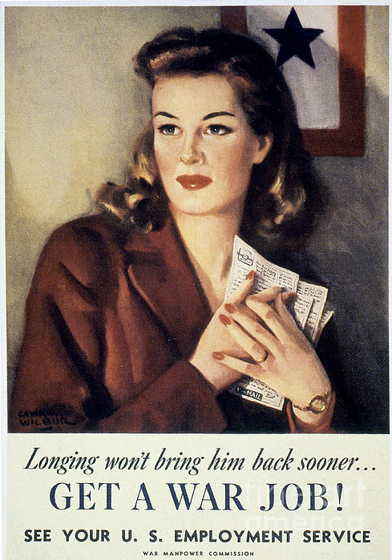

Slide 12
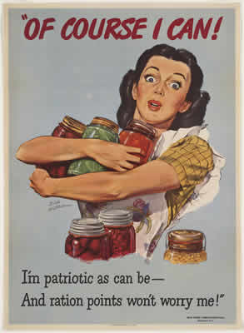

Slide 13
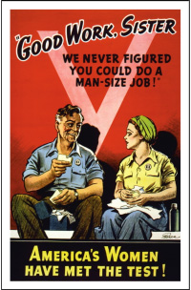

Slide 15
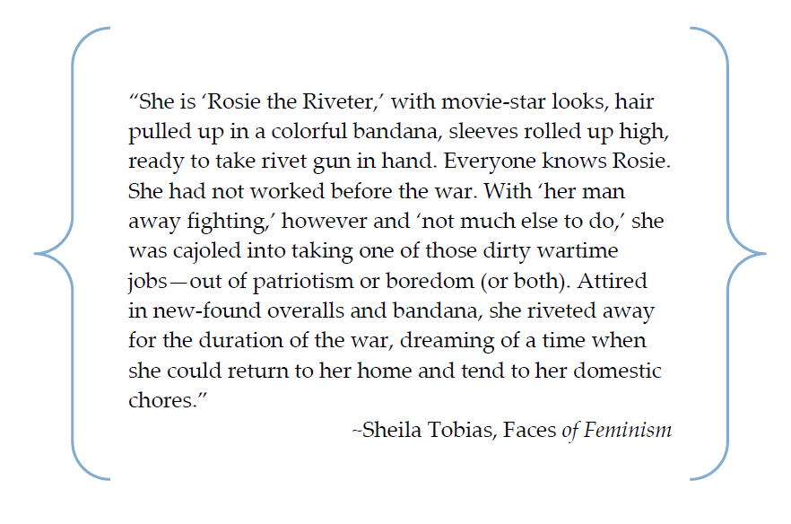

Slide 16
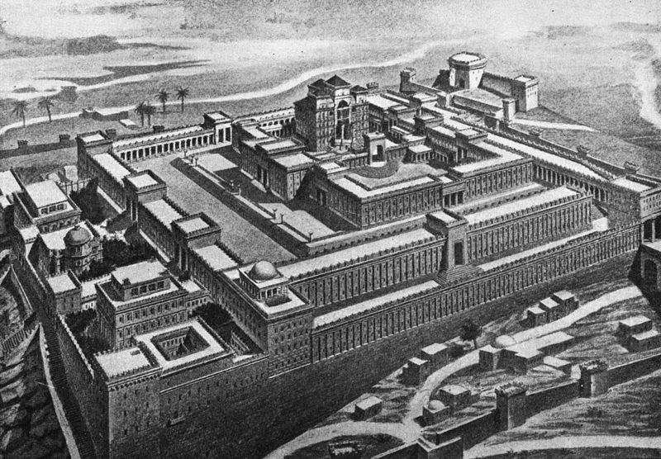
“I ran to the synagogue to weep over the destruction of the Temple.” (14)

Slide 17
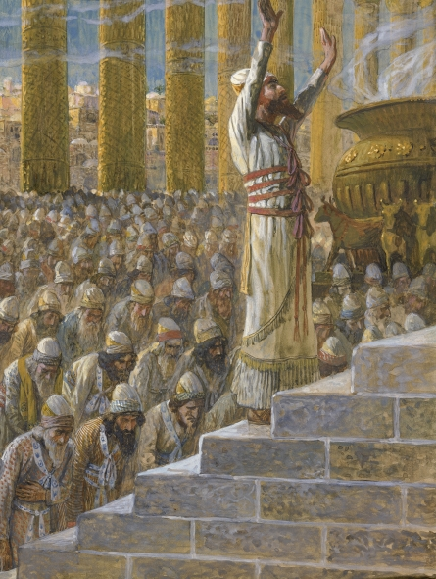
This references King Solomon’s Temple built in Judea, the Kingdom of the Jews.
Today, Judea would be present day Israel, including the city of Jerusalem. This is considered the Jewish holy land.
Solomon built the grand temple as a place for his people to worship.
It was dedicated to Yahweh, the Hebrew term for God.
Solomon

Slide 18
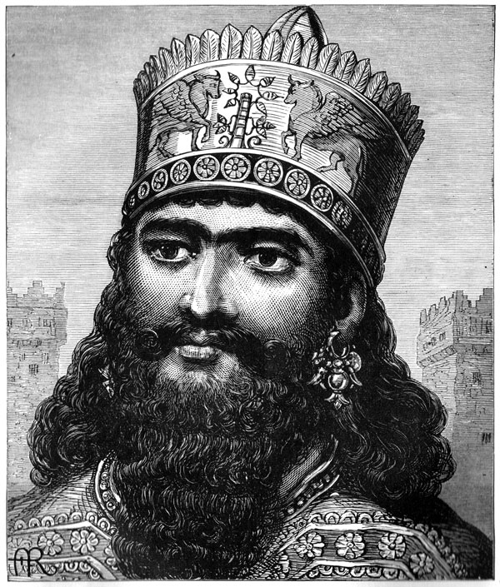
400 years after the temple was built, Nebuchadnezzar, a Babylonian king, invaded Judea.
Nebuchadnezzar burns Solomon’s temple and exiled the Jews from their holy land. This is known in the Jewish faith as the Exile of Providence.
Providence is defined as God’s care of all living creatures on Earth.
“You could hear told of the Exile of Providence, who, according to the Cabbala, awaits his deliverance in that of man.” (13)
Nebuchadnezzar

Slide 19
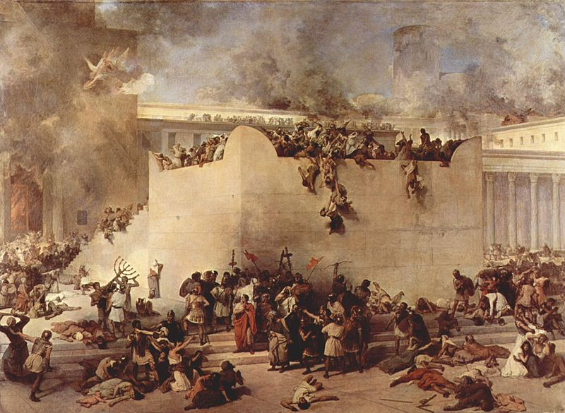

Slide 20
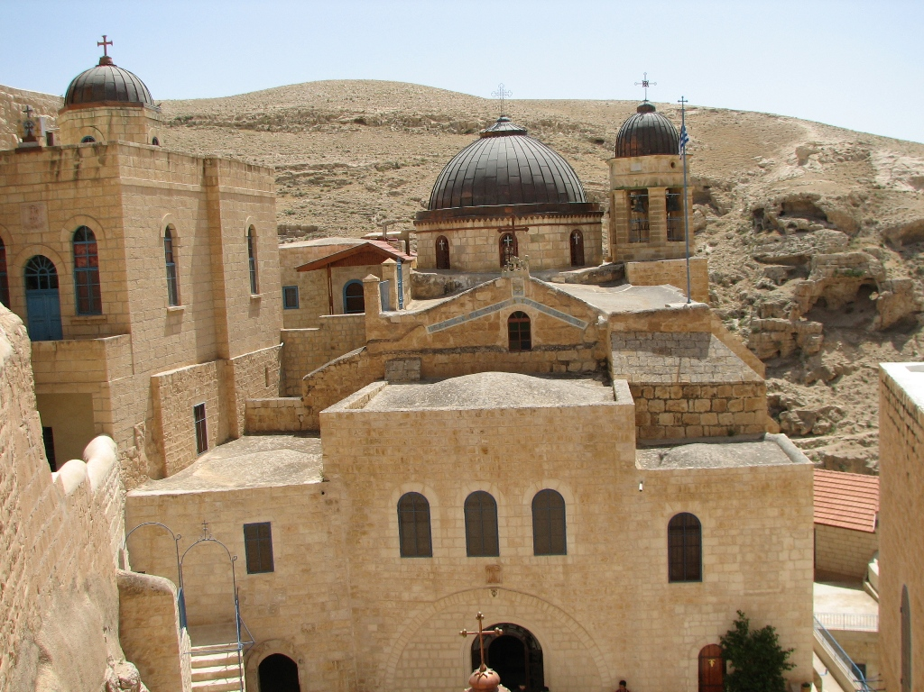
After the destruction of the temple and their exile, Jews have been in battle to reclaim their holy land. This conflict still exists today over Jerusalem as Jewish, Christian, and Islamic worshippers still fight over the city.
The Jews have been literally exiled from their land over time, but the term “Exile of Providence” has come to be very metaphorical for the Jewish faith.
At the time Elie is growing up, the Exile of Providence has come to stand for a metaphorical separation from God.

Slide 21
Jews believe that upon the coming of the Messiah (which is not Jesus), they will once again close this distance that exists between them and God and be holy once more.
It is also foretold that when the Messiah comes, the Jews will once again take over Judea, rebuild Solomon’s temple even grander than it was before, and be stronger in their faith.
So how does the allusion add to the memoir, Night?

Slide 22
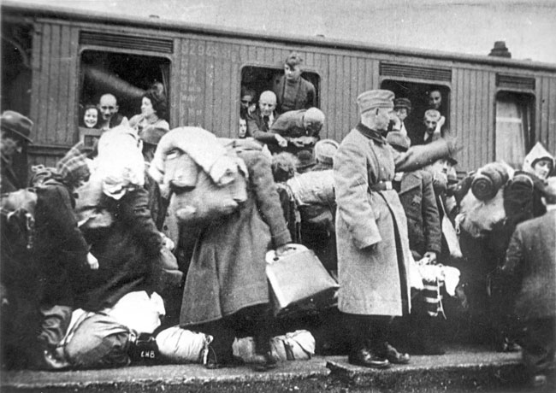

Slide 23
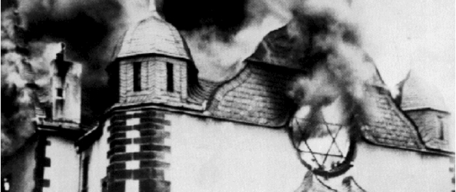
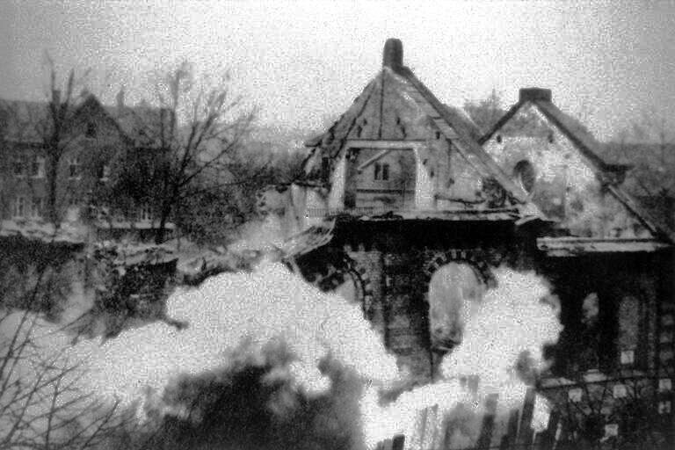
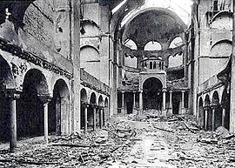

Slide 24
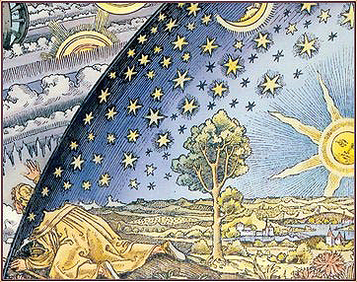

Slide 25
