Slide 1
What Are rhetorical appeals?
Rhetoric: the art of argument, anything used to persuade
Ethos- appeal to character, credibility
Logos- appeal to logic
Pathos- appeal to emotion

Slide 2
Buy my old car because I’m Mr. Davis and my grandpa once sold the most cars in the state.
Buy my old car because yours is broken and mine is the only one on sale.
Buy my old car or this cute little kitten, afflicted with a rare degenerative disease, will expire in agony, for my car is the last asset I have in this world and I’m selling it to pay for kitty’s medical treatments.

Slide 3
Ethos:
Are you trustworthy?
Do you have locus standi, or right to standing, on speaking about the subject
Are you speaking in good faith?
Decorum: do you meet the expectations of your audience?
“You persuade a man insofar as you can talk his language by speech, gesture, tonality, order, image, attitude, & idea, identifying your ways with his.”

Slide 4
Logos:
Defining your terms/Position and supporting it. (research, statistics)
Use “commonplaces” (truths that are widely accepted)
Create syllogisms (connections between points of an argument)– All men are mortal. Aristotle is a man. Therefore Aristotle is mortal.
“The audience takes pleasure in themselves for anticipating the point.”

Slide 5
Pathos:
The various emotions you feel as an audience member.
Can range depending on the occasion and the audience.

Slide 9
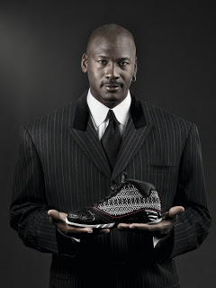

Slide 11
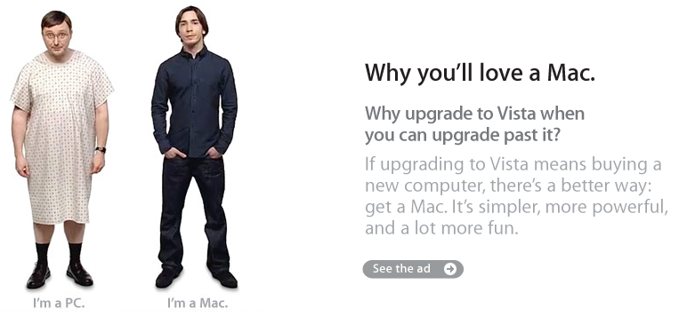

Slide 12
Enlist in the army to fight for the interests of the family you’ll be protecting back home. Don’t let your son or daughter become a victim to the oppression we, as Americans, fight to destroy.
Washington, Roosevelt, Lee, Powell. Protect the interests of your country like these men have. Fulfill your obligation to the ideals of freedom that others have preserved for you. Enlist.
We’re no “poor man’s force.” Research shows more service members have some college education than the typical 18- to 24-year-old. Let us help you while you help your country. Enlist now.

Slide 13
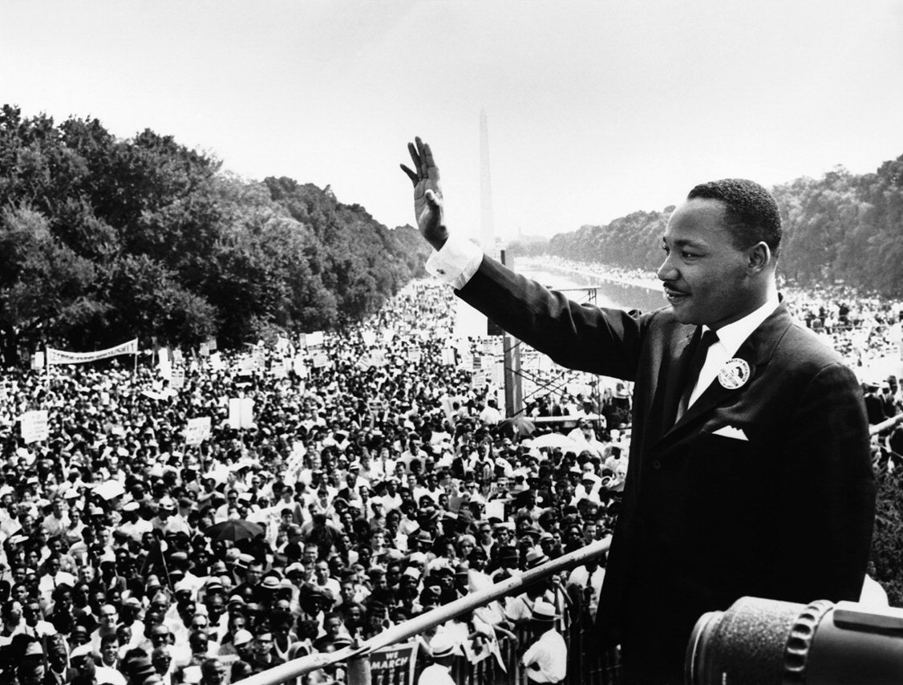
"I am not unmindful that some of you have come here out of great trials and tribulations. Some of you have come fresh from narrow jail cells. And some of you have come from areas where your quest -- quest for freedom left you battered by the storms of persecution and staggered by the winds of police brutality. You have been the veterans of creative suffering. Continue to work with the faith that unearned suffering is redemptive. Go back to Mississippi, go back to Alabama, go back to South Carolina, go back to Georgia, go back to Louisiana, go back to the slums and ghettos of our northern cities, knowing that somehow this situation can and will be changed.“
Martin Luther King Jr.
“I Have a Dream,” August 28th, 1963.

Slide 14
"And I am convinced that my record, going back to my opposition from sending the Marines to Lebanon, to supporting our efforts in Kosovo and Bosnia and the first Gulf War, and my judgment, I think, is something that ... I'm willing to stand on.“
John McCain
2008, second presidential debate

Slide 15
We don’t have single-sex toilets at home, and we don’t need them at the office. Then there’s also the small question of efficiency. I see my male colleagues waiting in line to use the men’s room, when the women’s toilet is unoccupied. Which is precisely why Delta Airlines doesn’t label those two bathrooms at the back of the plane as being solely for men and women. It just wouldn’t fly.
Ian Ayers
“Looking Out for No. 2” Slate Magazine, 2005

Slide 17
Rhetoric is defined as anything that is persuasive. By extension, Foster-Wallace must be trying to convince us of something. What would that something be? ie what is his purpose for writing this speech? Its main message(s)?
Aristotle says that all quality rhetoric must possess the Three Musketeers, or rhetorical appeals. Identify one example of each in the text.
Think about this speech through the lens of our novel Siddhartha. Select at least three quotations/ideas from Foster-Wallace’s speech and explain how they connect to the novel.

